Slide 1
Machine Learning 03- Model Predictions
Dr. Malak Abdullah
Computer Science Department
Jordan University of Science and Technology

Slide 2
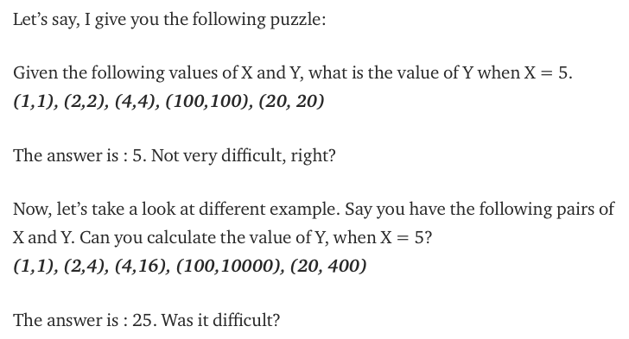
Before we start!
The relationship between X and Y is Y = X
The relationship is Y = X*X

Slide 3
Overall, machine learning works in the same way!
Your computer looks at some examples and then tries to identify “the most suitable” relationship between the sets X and Y.
Using this identified relationship, it will try to predict (or more) for new examples for which you don’t know Y.

Slide 4
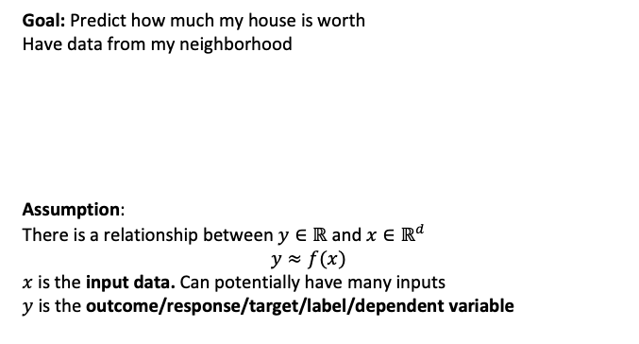
Fitting Data
Goal: Predict how much my house is worth
Have data from my neighborhood
Assumption:
There is a relationship between $y∈ℝ$ and $x∈ℝ^{d}$
$$y≈f(x)$$
$x$ is the input data. Can potentially have many inputs
$y$ is the outcome/response/target/label/dependent variable

Slide 5
What is Regression?
Regression is usually termed as determining relationship(s) between two or more variables.
X and Y are the variables, X is termed as the independent variable and Y is termed as the dependent variable and Y has a continuous range (unlike classification where Y is discrete).
If we had multiple input attributes (e.g. x1, x2, x3, etc.) This would be called multiple linear regression.

Slide 6
The machine learning framework
y = f(x)
output
prediction function
Image feature
Training: given a training set of labeled examples {(x₁,y₁), …, (x_{N},y_{N})}, estimate the prediction function f by minimizing the prediction error on the training set
Testing: apply f to a never-before-seen test example x and output the predicted value y = f(x)
Slide credit: L. Lazebnik

Slide 7
Types of Regression Models
1 Explanatory Variable
Regression
2+ Explanatory Variables
Models
Simple
Multiple
Non-
Non-
Linear
Linear
Linear
Linear
Notes:
24
This teleology is based on the number of explanatory variables & nature of relationship between X & Y.

Slide 8
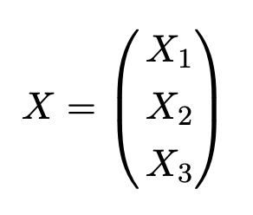
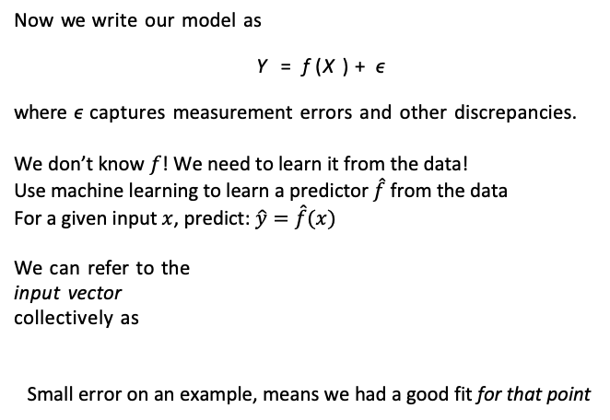
Prediction
Now we write our model as
Y = f (X) + ϵ
where ϵ captures measurement errors and other discrepancies.
We don’t know $f$! We need to learn it from the data!
Use machine learning to learn a predictor $\hat{f}$from the data
For a given input $x$, predict: $\hat{y}=\hat{f}(x)$
We can refer to the
input vector
collectively as
Small error on an example, means we had a good fit for that point

Slide 9
Basic Idea
Try a bunch of different lines and see which one is best!
What does best even mean here?

Slide 10
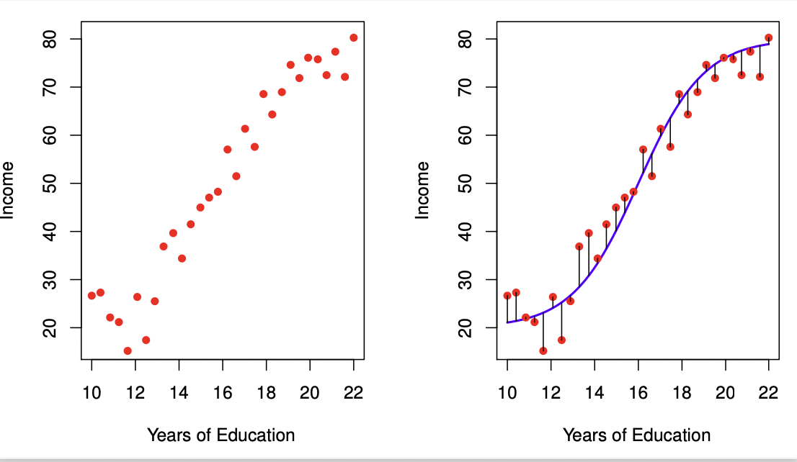
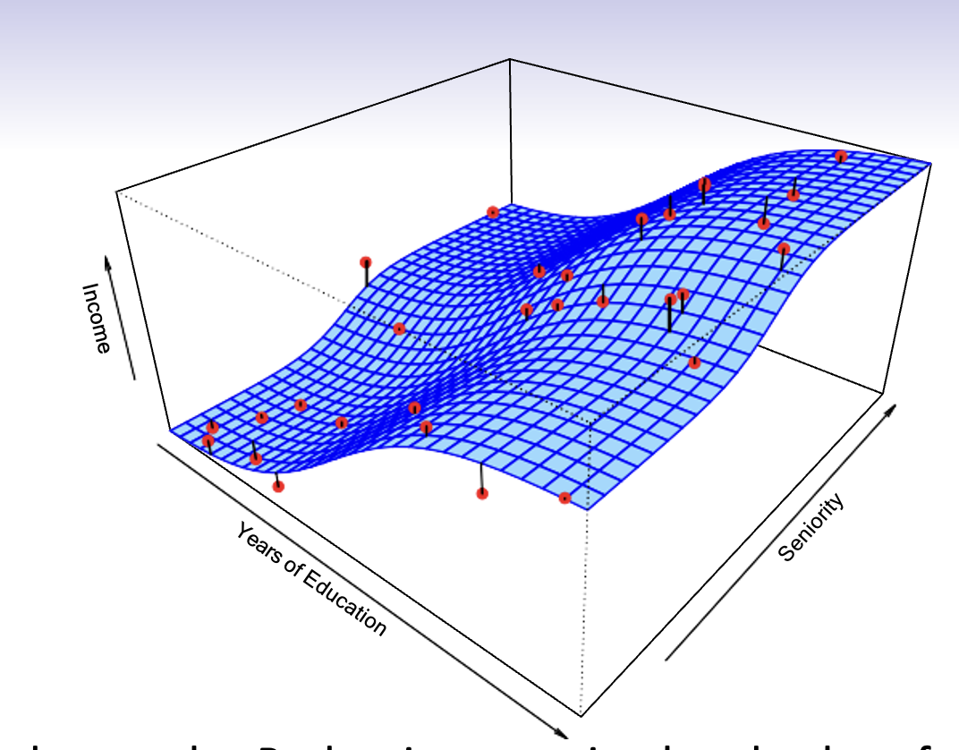
What is f (X) good for?
With a good f, we can make predictions of Y at new points
X = x.
We can understand which components of
X = (X₁, X₂, . . . , X_{p}) are important in explaining Y, and which are irrelevant. e.g. Seniority and Years of Education have a big impact on Income, but Marital Status typically does not.
Depending on the complexity of f, we may be able to understand how each component X_{j} of X affects Y.
10 / 30

Slide 11
6
●●
● ●
●●
● ● ●
●●● ● ●
4
●●●●●●●●●●
● ●●● ● ●
● ●●●●●●●●● ●
●
● ●●●●●●
●●●●●●●●●● ●●
●●●●●● ●●●●●
●●
●●●●●●●●●●●●●
y
● ●●●●●●●●●●●●●●●
2
● ●●●●●●●●● ●●●●●●●
● ●●●●●●●●●●●●●● ●
●
●●●●●●●●●●●●●●●●●●●●●●●●
●●●●●●●●●●●●●●●● ●●●●● ●
●
●
●●●●●●●●●●●●●●●●●●●●●●●●●
●
● ●●●●●●●●●●●●●●●●●●●●●●●●●●●●●
● ●
● ●●●●●●●●●●●●●●●●●●●●●●●●●●●
● ●
●●● ●●●●●●●●●●●●●●●●●●●●● ●●●●●●●●●●●●●●●●●●
●
●●
●● ●●●●●●●●● ●●●●●●●●●●●●●●● ●●●●●●
−2 0
● ●●● ● ●●●● ●●●●●●● ●●●●● ●●●●●●●●●●●●●●●●●●●●●
●● ●●● ●●● ●●● ●●●●●●●●●●●●●●●●●●●●●●●●●● ●●●●●●●●●●●●●●
● ● ●●●●●●●●●●●●●●●●●●●●●●●●●●●●●●●●●●●●●●●●●●●● ●●●
●● ●●●●●●●●●●●●●●●●●●● ●●● ●●● ●●●●●●●●●●●●●●●●●
●●●●● ●●●●●●●●●●●●●●●●●●●●●●●●●●●●●●●● ●
●●● ●●●●● ●●●●●●●●●●●●●●●●● ●● ●●● ●
●● ●●●●●●●●●●●●●●● ● ●●●●●
● ● ●●●●●●●●●●● ●●● ●● ●
●
●● ● ●●
1
2
3 4
x
5
6
7
Is there an ideal f (X)? In particular, what is a good value for f (X) at any selected value of X, say X = 4? There can be many Y values at X = 4. A good value is
f (4) = E(Y |X = 4)
E(Y |X = 4) means expected value (average) of Y given X = 4.
This ideal f (x) = E(Y |X = x) is called the regression function.
4 / 30

Slide 12
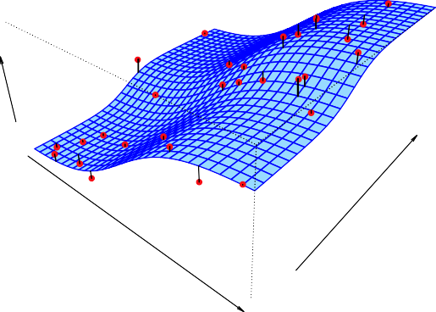
Income
Seniority
Years of Education
Simulated example. Red points are simulated values for income
from the model
income = f (education, seniority) + ϵ f is the blue surface.

Slide 13
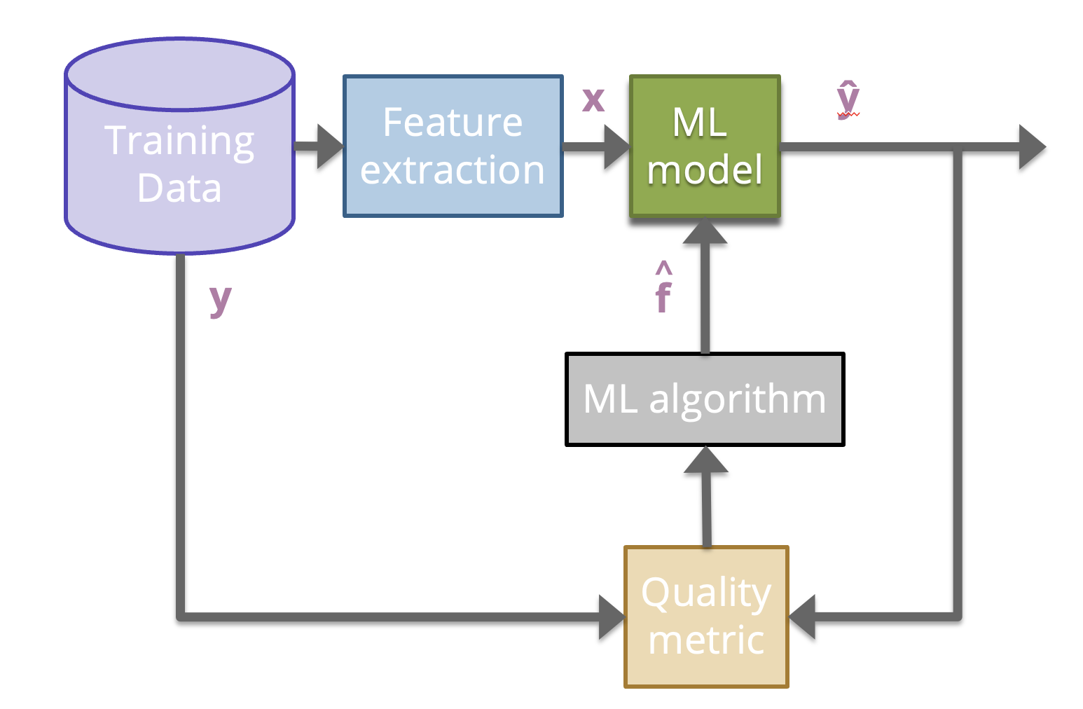
ML Pipeline

Slide 14
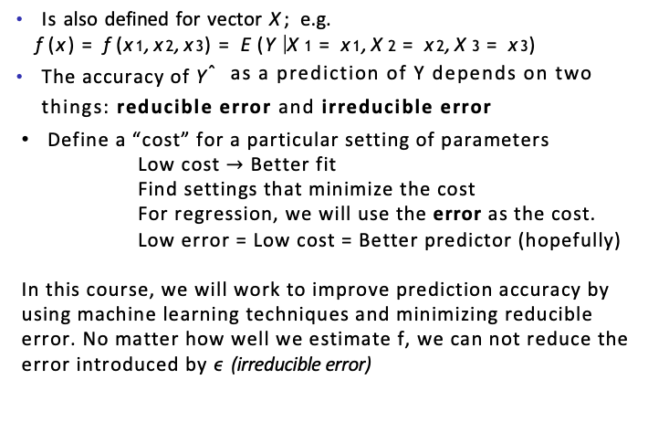
The regression function f (x)
Is also defined for vector X; e.g.
f (x) = f (x₁, x₂, x₃) = E(Y |X₁ = x₁, X₂ = x₂, X₃ = x₃)
The accuracy of Yˆ as a prediction of Y depends on two things: reducible error and irreducible error
Define a “cost” for a particular setting of parameters
Low cost $→$ Better fit
Find settings that minimize the cost
For regression, we will use the error as the cost.
Low error = Low cost = Better predictor (hopefully)
In this course, we will work to improve prediction accuracy by using machine learning techniques and minimizing reducible error. No matter how well we estimate f, we can not reduce the error introduced by ϵ (irreducible error)

Slide 15
How Do we estimate f?
Parametric methods: The linear model is an important example of a parametric model:
f_{L}(X) = β₀ + β₁X₁ + β₂X₂ + . . . β_{p}X_{p}.
A linear model is specified in terms of p + 1 parameters
β₀, β₁, . . . , β_{p}.
We estimate the parameters by fitting the model to training data.
Although it is almost never correct, a linear model often serves as a good and interpretable approximation to the unknown true function f (X).
Some more examples of parametric machine learning algorithms include Logistic Regression, Naive Bayes, and Simple Neural Networks.

Slide 16
A linear model f^{ˆ}_{L}(X) = β^{ˆ}₀ + β^{ˆ}₁X gives a reasonable fit here
−2 −1 0 1 2 3
● ●
●
●
●●
●
●
●
● ●
●
●●
●
●
● ● ●●
● ●●●
y
●
●
● ●● ●●
●
●
●
●
●
● ●
● ●●
●
●
● ● ●
●
● ●
●
● ●●
● ● ● ●
● ●● ●●
● ● ●
●
1 2 3 4 5 6
x
A quadratic model f^{ˆ}_{Q}(X) = β^{ˆ}₀ + β^{ˆ}₁X + β^{ˆ}₂X² fits slightly better.
−2 −1 0 1 2 3
● ●
●
●
●●
●
● ●
● ●
●●
● ●●●
●
● ●
y
●
● ● ●●
●● ●●
●
●
● ●
● ●
● ●●
●
● ●
●
● ● ●
●
● ●
●
●
● ●●
● ● ● ●
● ●● ●●
● ● ●
●
1
2
3
4
5
6
x

Slide 17
Income
Seniority
Years of Education
Simulated example. Red points are simulated values for income
from the model
income = f (education, seniority) + ϵ f is the blue surface.

Slide 18
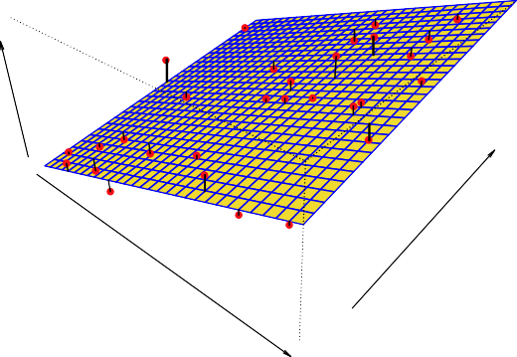
Income
Seniority
Years of Education
Linear regression model fit to the simulated data.
f^{ˆ}_{L}(education, seniority) = β^{ˆ}₀+β^{ˆ}₁×education+β^{ˆ}₂×seniority

Slide 19
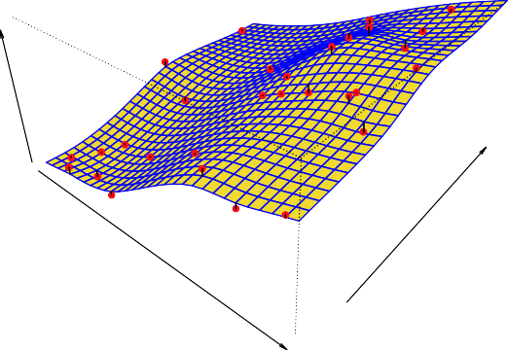
Income
Seniority
Years of Education
More flexible regression model f^{ˆ}_{S} (education, seniority) fit to the simulated data. Here we use a technique called a thin-plate spline to fit a flexible surface. We control the roughness of the fit (chapter 7).

Slide 20
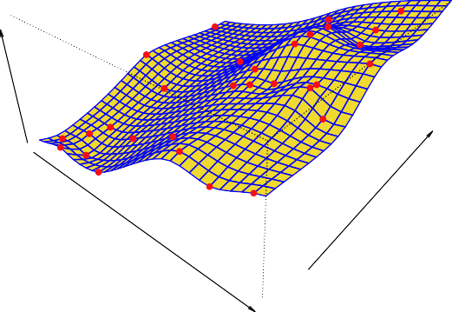
Income
Seniority
Years of Education
Even more flexible spline regression model
f^{ˆ}_{S} (education, seniority) fit to the simulated data. Here the fitted model makes no errors on the training data! Also known as overfitting.

Slide 21
How Do we estimate f?
Non-Parametric methods: An easy-to-understand nonparametric model is the k-nearest neighbors algorithm that makes predictions based on the k most similar training patterns for a new data instance. The method does not assume anything about the form of the mapping function other than patterns that are close are likely to have a similar output variable.
Some more examples of popular nonparametric machine learning algorithms are:
k-Nearest Neighbors
Decision Trees like CART and C4.5
Support Vector Machines

Slide 22
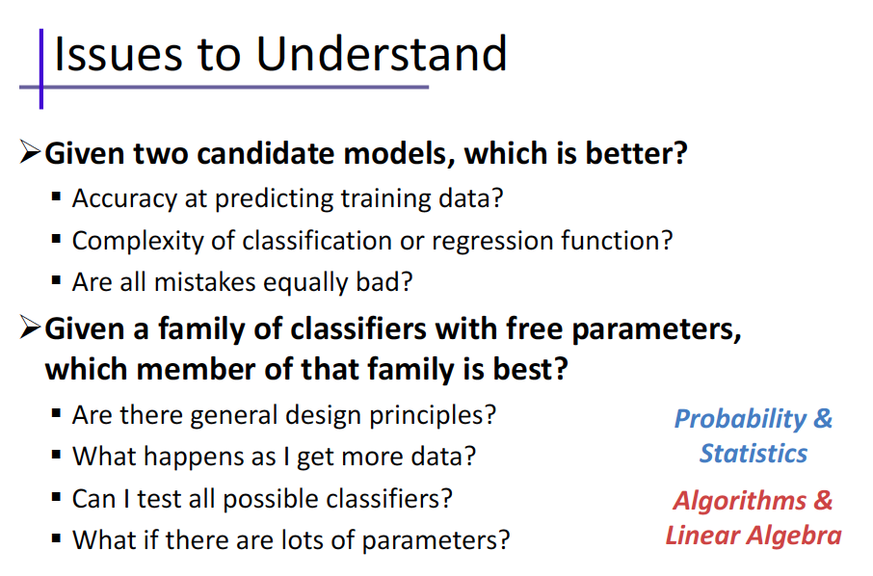

Slide 23
Generalization
Definition: model does a good job of correctly predicting class labels of previously unseen samples
Generalization is typically evaluated using a test set of data that was not involved in the training process
Evaluating generalization requires:
Correct labels for test set are known.
A quantitative measure (metric) of tendency for model to predict correct labels.

Slide 24
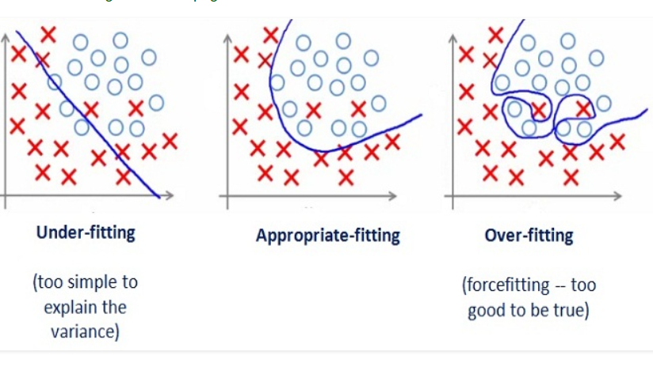
Generalization
Underfitting: model is too “simple” to represent all the relevant class characteristics
Overfitting: model is too “complex” and fits irrelevant characteristics (noise) in the data

Slide 25
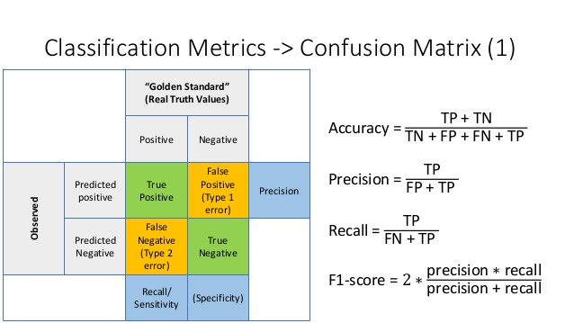
Metrics for classifier performance
Confusion Matrix is a performance measurement for machine learning classification.
Notes:
Metrics for classifier performance can be used on any labeled partition of the data: training, validation, or test.

Slide 26
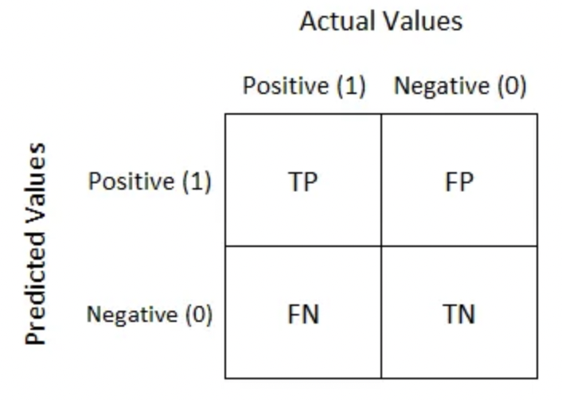
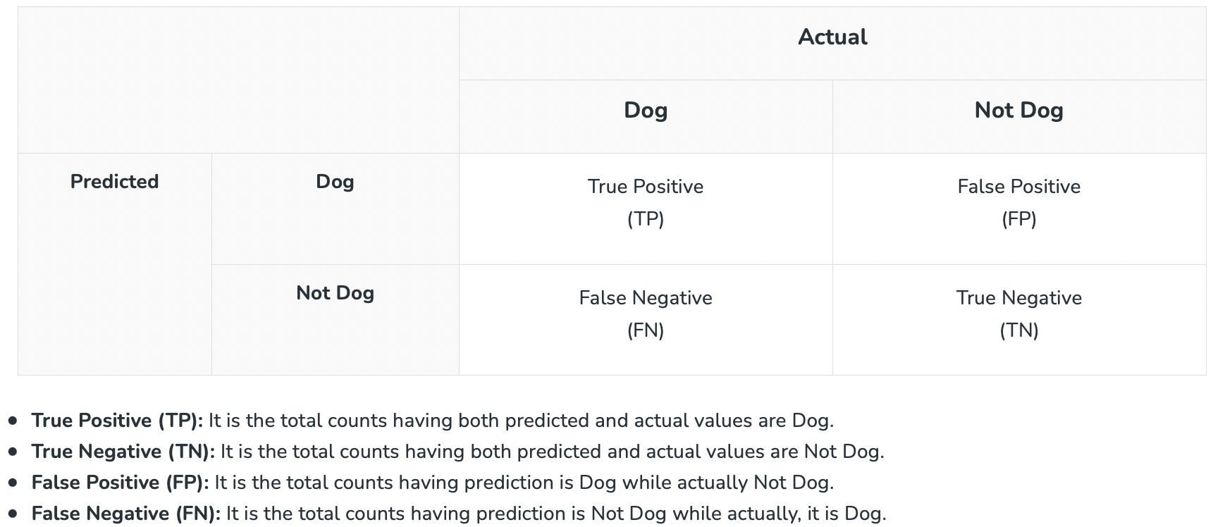
Confusion Matrix
The matrix displays the number of instances produced by the model on the test data.
True positives (TP): occur when the model accurately predicts a positive data point.
True negatives (TN): occur when the model accurately predicts a negative data point.
False positives (FP): occur when the model predicts a positive data point incorrectly.
False negatives (FN): occur when the model mispredicts a negative data point.
Example

Slide 27
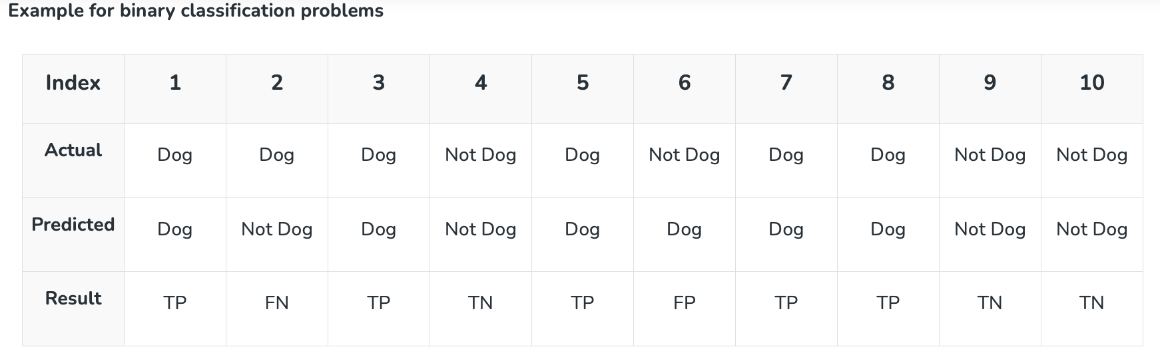
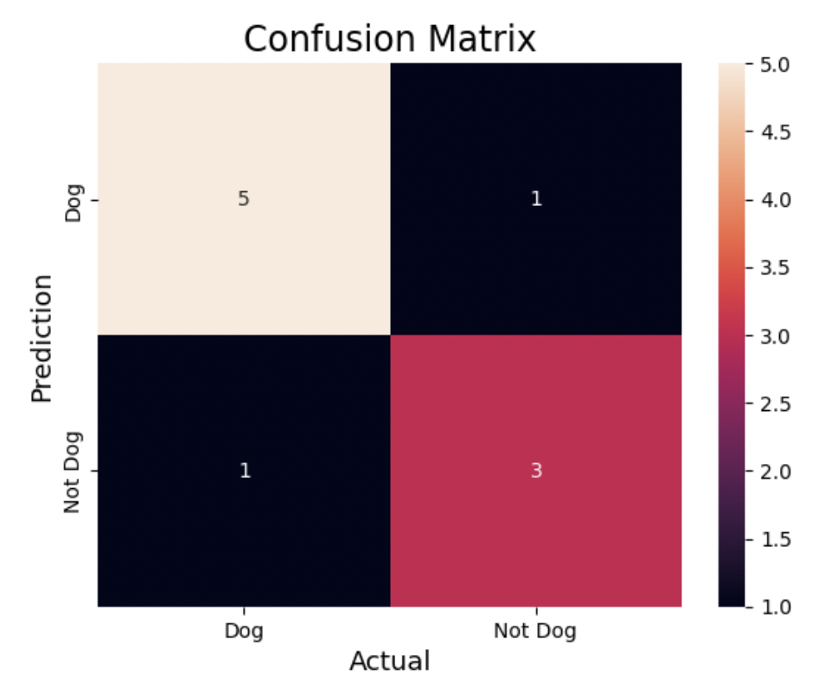
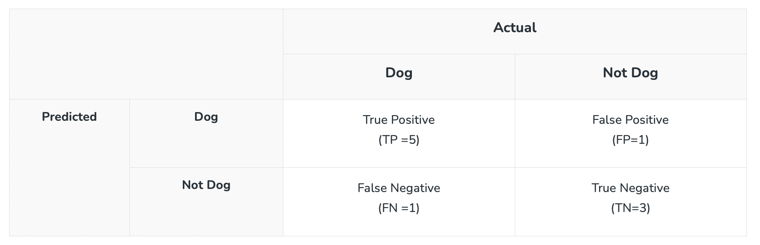
Actual Dog Counts = 6
Actual Not Dog Counts = 4
True Positive Counts = 5
False Positive Counts = 1
True Negative Counts = 3
False Negative Counts = 1

Slide 28
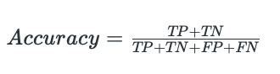
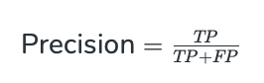
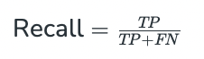
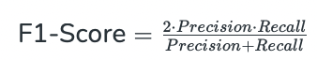
1. Accuracy
Accuracy is used to measure the performance of the model. It is the ratio of Total correct instances to the total instances.
For the above case:
Accuracy = (5+3)/(5+3+1+1) = 8/10 = 0.8
2. Precision
is a measure of how accurate a model’s positive predictions are. It is defined as the ratio of true positive predictions to the total number of positive predictions made by the model.
Precision = 5/(5+1) =5/6 = 0.8333
3. Recall
measures the effectiveness of a classification model in identifying all relevant instances from a dataset. It is the ratio of the number of true positive (TP) instances to the sum of true positive and false negative (FN) instances.
Recall = 5/(5+1) =5/6 = 0.8333
4. F1-Score
is used to evaluate the overall performance of a classification model. It is the harmonic mean of precision and recall,
F1-Score: = (2* 0.8333* 0.8333)/( 0.8333+ 0.8333) = 0.8333
We balance precision and recall with the F1-score when a trade-off between minimizing false positives and false negatives is necessary, such as in information retrieval systems.

Slide 29
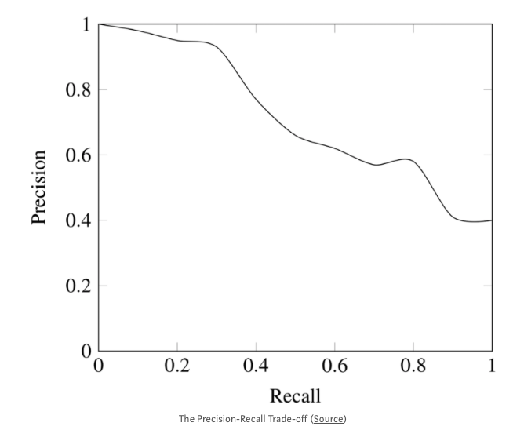
Trade-off
While recall expresses the ability to find all relevant instances in a dataset, precision expresses the proportion of the data points our model says was relevant actually were relevant.
Accuracy should NEVER be used as a measure when the target variable classes in the data are a majority of one class.
Ex: In our cancer detection example with 100 people, only 5 people has cancer. Let’s say our model is very bad and predicts every case as No Cancer. In doing so, it has classified those 95 non-cancer patients correctly and 5 cancerous patients as Non-cancerous. Now even though the model is terrible at predicting cancer, The accuracy of such a bad model is also 95%.

Slide 30

How to evaluate your model
Example: A school is running a machine learning primary diabetes scan on all of its students. The output is either diabetic (+ve) or healthy (-ve).
Accuracy answers the following question: How many students did we correctly label out of all the students?
Precision answers the following: How many of those who we labeled as diabetic are actually diabetic? = TP / (TP+FP)
Recall answers the following question: Of all the people who are diabetic, how many of those we correctly predict? = TP / (TP+FN)

Slide 31
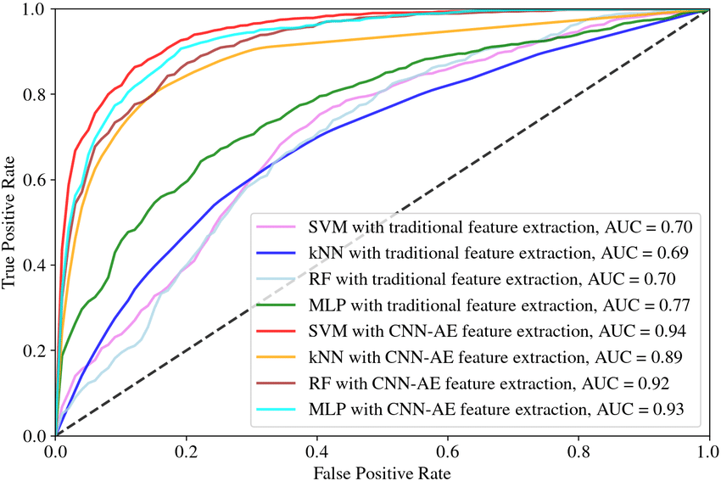
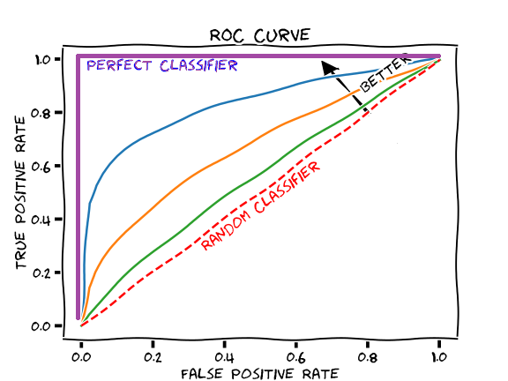
ROC AUC
A receiver operating characteristic curve→ ROC curve
Area under the ROC Curve → AUC

Slide 32
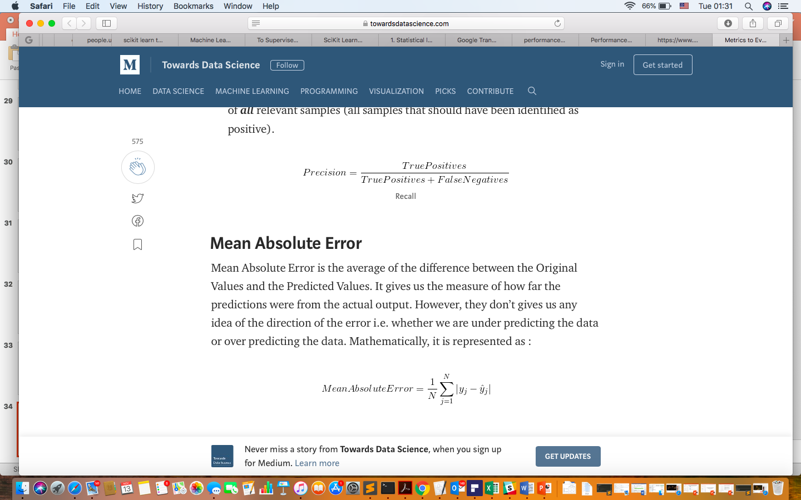
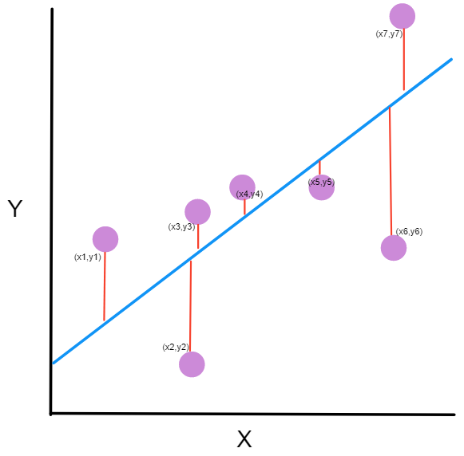
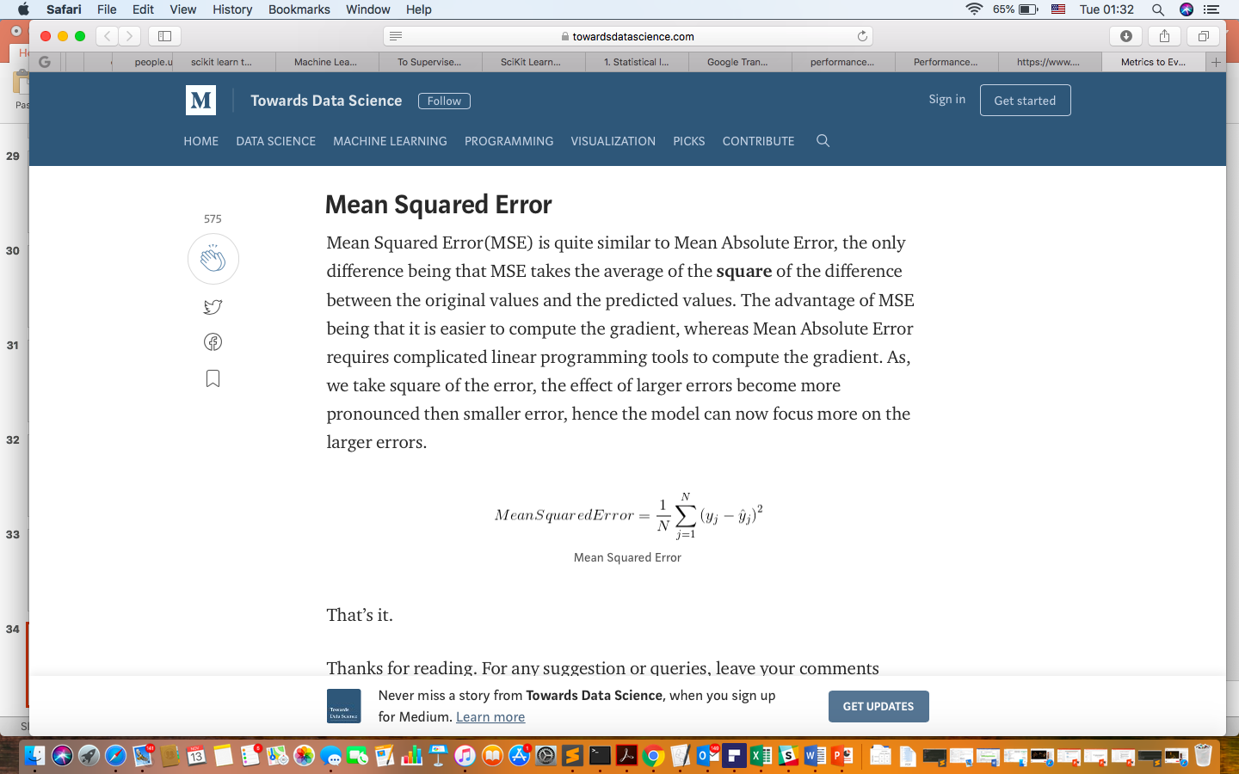
How to evaluate your Regression model
1.
2.

Slide 33
Some trade-offs
Prediction accuracy versus interpretability.
Linear models are easy to interpret; thin-plate splines are not.
Good fit versus over-fit or under-fit.
How do we know when the fit is just right?
Parsimony versus black box.
We often prefer a simpler model involving fewer variables over a black-box predictor involving them all.

Slide 34
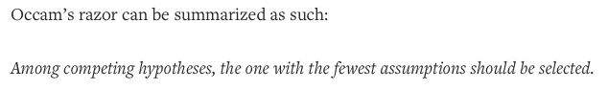
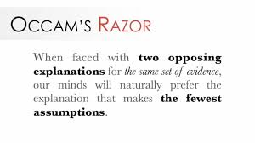
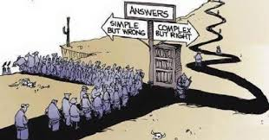
Occam’s Razor
Given two models with similar generalization errors, one should prefer the simpler model over the more complex model.
For complex models, there is a greater chance it was fitted accidentally by errors in data.
Model complexity should therefore be considered when evaluating a model.

Slide 35
High
Subset Selection Lasso
Least Squares
Generalized Additive Models Trees
Interpretability
Bagging, Boosting
Support Vector Machines
Low
Low
High
Flexibility

Slide 36
Assessing Model Accuracy
Suppose we fit a model f^{ˆ}(x) to some training data
N
Tr = {x , y } , and we wish to see how well it performs.
i i
1
We could compute the average squared prediction error over Tr:
MSE_{Tr} = Ave_{i∈Tr}[y_{i} − f^{ˆ}(x_{i})]²
This may be biased toward more overfit models.
Instead we should, if possible, compute it using fresh test
M
data Te = {x , y } :
i i
1
MSE_{Te} = Ave_{i∈Te}[y_{i} − f^{ˆ}(x_{i})]²

Slide 37
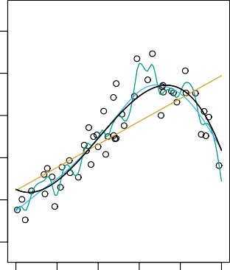
2.5
12
2.0
10
Mean Squared Error
1.5
8
Y
6
1.0
4
0.5
2
0.0
0
20
40
60
80 100
2
5
10 20
X Flexibility
Black curve is truth. Red curve on right is MSE_{Te}, grey curve is MSE_{Tr}. Orange, blue and green curves/squares correspond to fits of different flexibility.

Slide 38
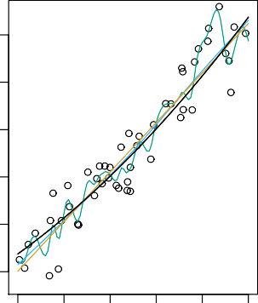
2.5
12
2.0
10
Mean Squared Error
1.5
8
Y
6
1.0
4
0.5
2
0.0
0
20
40
60
80 100
2
5
10 20
X Flexibility
Here the truth is smoother, so the smoother fit and linear model do really well.

Slide 39
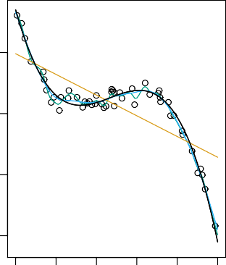
20
20
Mean Squared Error
15
10
Y
10
0
5
−10
0
0
20
40
60
80 100
2
5
10 20
X Flexibility
Here the truth is wiggly and the noise is low, so the more flexible fits do the best.
20 / 30

Slide 40
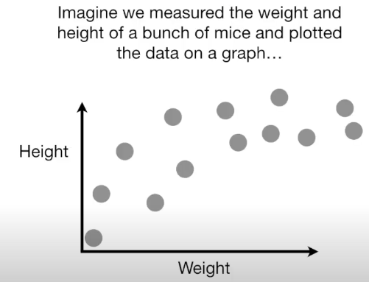
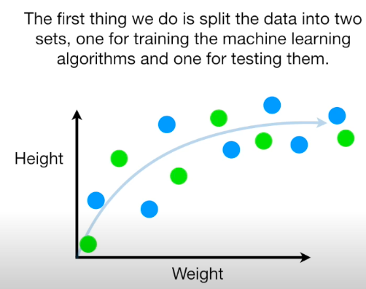
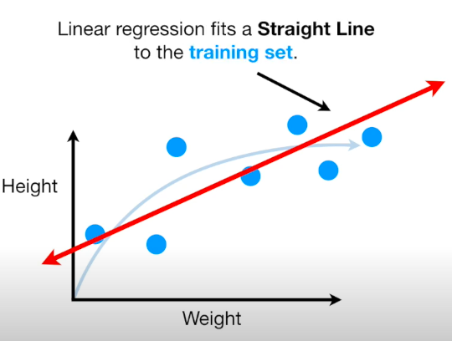
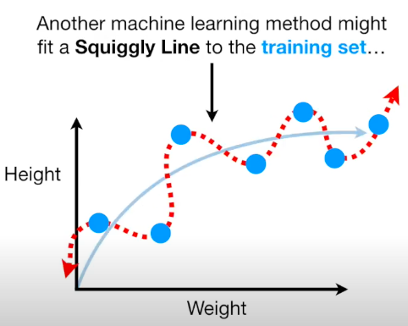
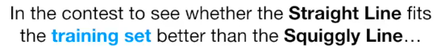
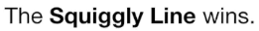
Lets talk about Bias vs Variance

Slide 41
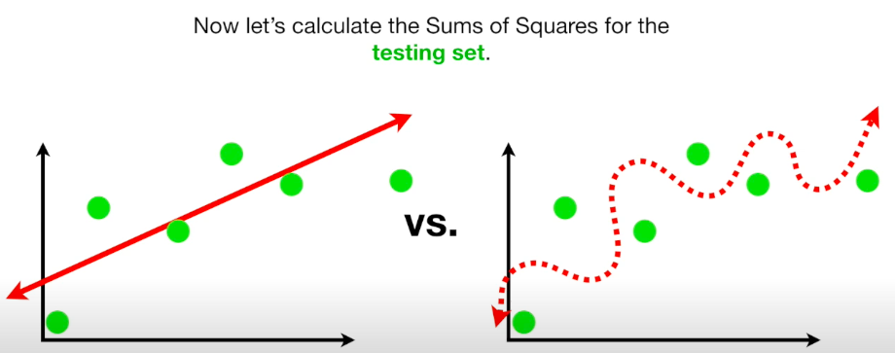
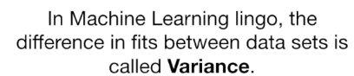
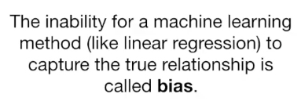
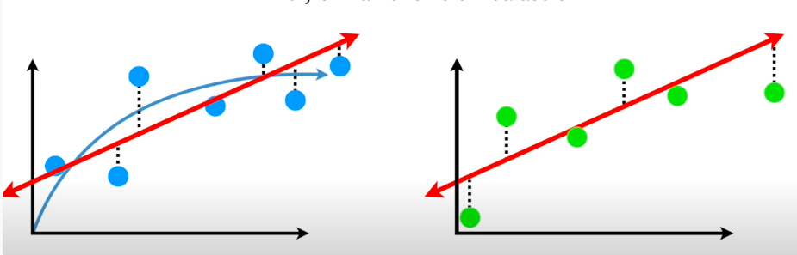
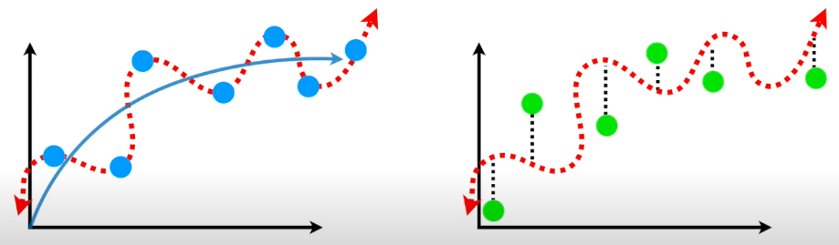
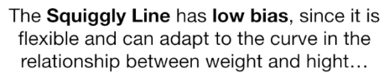
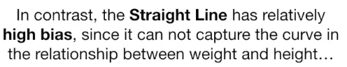
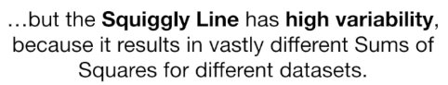


Slide 42




Slide 43
Bias-Variance Trade-off
Suppose we have fit a model f^{ˆ}(x) to some training data Tr, and let (x₀, y₀) be a test observation drawn from the population. If the true model is Y = f (X) + ϵ (with f (x) = E(Y |X = x)), then
ˆ
2
ˆ ˆ
2
E y − f (x ) = Var(f (x )) + [Bias(f (x ))] + Var(ϵ).
0 0 0 0
The expectation averages over the variability of y₀ as well as the variability in Tr. Note that Bias(f^{ˆ}(x₀))] = E[f^{ˆ}(x₀)] − f (x₀).
Typically as the flexibility of f^{ˆ} increases, its variance increases, and its bias decreases. So choosing the flexibility based on average test error amounts to a bias-variance trade-off.
43 / 30

Slide 44
Bias-variance trade-off for the three examples
2.5
2.5
20
MSE
Bias Var
2.0
2.0
15
1.5
1.5
10
1.0
1.0
0.5
0.5
5
0.0
0.0
0
2
5 10 20
2
5 10 20
2
5 10 20
Flexibility
Flexibility
Flexibility
44 / 30

Slide 45

Early stopping
Stop training as soon as the validation error reaches a minimum.

Slide 46
Classification Problems
Here the response variable Y is qualitative — e.g. email is one of C = (spam, ham) (ham=good email), digit class is one of
C = {0, 1, . . . , 9}. Our goals are to:
Build a classifier C(X) that assigns a class label from C to a future unlabeled observation X.
Assess the uncertainty in each classification
Understand the roles of the different predictors among
X = (X₁, X₂, . . . , X_{p}).
46 / 30

Slide 47
0.0 0.2 0.4 0.6 0.8 1.0
| | | | | || | ||| || |||||||||||||||| |||| | ||| || | | | || || | | | | | | || | |||||| |||||| |||| ||| | | ||
y
|| | | || ||| || || ||| | |||| | | | |
2 3
| || |||||| || ||||||| | |
1
4
5
6
7
x
Is there an ideal C(X)? Suppose the K elements in C are
numbered 1, 2, . . . , K. Let
p_{k}(x) = Pr(Y = k|X = x), k = 1, 2, . . . , K.
These are the conditional class probabilities at x; e.g. see little barplot at x = 5. Then the Bayes optimal classifier at x is
C(x) = j if p_{j} (x) = max{p₁(x), p₂(x), . . . , p_{K} (x)}
47 / 30

Slide 48
0.0 0.2 0.4 0.6 0.8 1.0
| |
| | | || || || || || || |||| ||| | | ||||||| || || | |||| || | || | |
y
| | | | | | | || | | | |||||| |||| | || | | || | || | | |
2
3
4
5
6
x
Nearest-neighbor averaging can be used as before.
Also breaks down as dimension grows. However, the impact on
C^{ˆ}(x) is less than on pˆ_{k}(x), k = 1, . . . , K.
48 / 30

Slide 49
Classification: some details
Typically we measure the performance of C^{ˆ}(x) using the misclassification error rate:
Err_{Te} = Ave_{i∈Te}I[y_{i} /= C^{ˆ}(x_{i})]
The Bayes classifier (using the true p_{k}(x)) has smallest error (in the population).
Support-vector machines build structured models for C(x).
We will also build structured models for representing the
p_{k}(x). e.g. Logistic regression, generalized additive models.
49 / 30

Slide 50
Example: K-nearest neighbors in two dimensions
_{o} o
o_{o}
o_{o}
_{o} o
o
o
_{oo} o_{o}
o
o
o o o^{oo}
o
_{o o}o o
_{o}oo_{o}oº o
oº o
oo
_{o}o
o
oo o
o
o o
o_{o}
o
o
o o_{o} o ºo _{o o} o
_{o}o
o
o
o o
o o
o o
ooo
o _{o}
o
oo
o _{o}o o o
o o
o _{o} o
oo o
oo
ooo º
X2
_{o} o
oo _{o}
_{o} o
o_{oo}o_{o}o_{o} o
o
o
o
o_{o o}o o _{o}
_{o o}o
o o
o o _{o}
o
oº oo
o
ooº
o
o
_{o} ooº o
o
oo
º ooo^{o o}oo
o _{o}
_{o}o
o oo o_{o} º
o
ºo o
o
o_{o} o
_{o}oºo _{o}o
o
oo
o
o
o
o
o
o
X1
50 / 30

Slide 51
KNN: K=10
_{o} o
o_{o}
o_{o}
o o
o
o o
_{oo} o_{o}
o
o
o o o^{oo}
_{o o}o o
_{o}oo_{o}^{oo} o
oº o
o
o
o
oo
o
o _{o o}
o o
oo o
o_{o}
o
o
_{o}o
ooº
o ºo
o
o o o _{o} o
o o
o o
o
o_{o}o
o
o _{o}o o _{o}
o
oo
o_{o}
o
o o _{o o o}
o_{o} o
ooo
X₂
_{o} o
oo _{o}
_{o} o
o_{oo}o_{o}o_{o o}
o
o
o
o_{o} o o _{o}
_{o o}o o
o o
o o _{o}
o
oº oo _{o}
ooº
o _{o}
_{o} ooº _{o}
o
oo
º ooo^{o o}oo
o _{o}
_{o}o
o _{o}o o_{o}
o o
o
ºo o
o_{o} o
_{o}oºo _{o}o
o
o
o
oº o
o
o
o
X₁
51 / 30

Slide 52
KNN: K=1
KNN: K=100
º_{o} o
º_{o} o
o ^{o o}
o o
o ^{o o}
o o
o
o
o
_{oo} o_{o}
o
o
_{oo} o_{o}
o
o
o o o^{oo}
o
o o o^{oo}
o
o
_{o}o o
oo ^{oo} o
o
o
_{o}o o
oo ^{oo} o
o o _{o}
o
o
o oº
ºo
o o _{o}
o
o
o oº
ºo
o
o _{o o} oo º
o º o ºo
o_{o}
o
o _{o o} oo º
o º o ºo
o_{o}
_{o}o
ooº
o o
o
o
o
_{o}o
ooº
o o
o
o
o
o o
o _{o} º o o
o
o o
o _{o} º o o
o
o _{o}o _{oo}
º o _{o}o o _{o}
o
o
o _{o}o _{oo}
º o _{o}o o _{o}
o
o
o o _{o o o} o_{o} o o o
ooo
o
o o _{o o o} o_{o} o o o
ooo
o
o
o º o oo
o
o º o oo
o o
o^{oo}o º
o o
o^{oo}o º
oo _{o}
o_{o} o o _{o}
o o
oo _{o}
o_{o} o o _{o}
o o
_{o o}o o
o o _{o}
_{o o}o o
o o _{o}
o
o
_{o} o ^{oo} _{o}
o
o
o
_{o} o ^{oo} _{o}
o
o
oº _{o} o
o
oº _{o} o
oo
o
oo
o
oo
º ooo^{o oo}
_{o} oo
oo
º ooo^{o oo}
_{o} oo
o
o
o
o
o
o
o
oº o ^{oo oo} o
o
oº o ^{oo oo} o
o_{o} o
o o
o_{o} o
o o
_{o}oºo _{o}º
_{o}oºo _{o}º
o
o
o
o
o
o
^{oo} o
o
o
^{oo} o
o _{o}
o _{o}
52 / 30

Slide 53
0.20
0.15
Error Rate
0.10
0.05
Training Errors Test Errors
0.00
0.01
0.02
0.05
0.10
0.20
0.50
1.00
1/K
53 / 30

